Slide 1
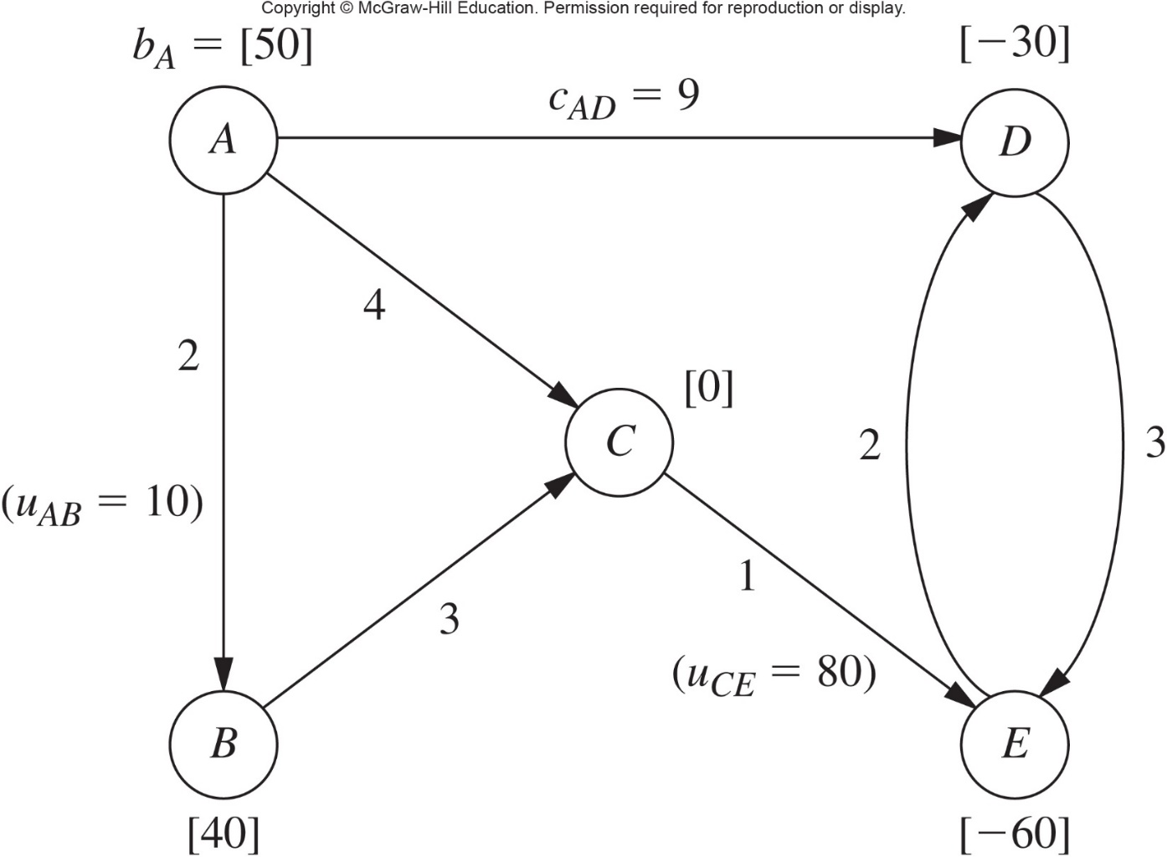
Distribution Unlimited Co. Minimum Cost Flow Problem
cost per unit flow through arc
The maximum shipping capacity
net flow generated at node
Notes:
Solving the P&T Co. example using a spreadsheet
See Figure 9.4 in the text
Solver uses the general simplex method
Rather than the streamlined version specifically designed for the transportation problem

Slide 2
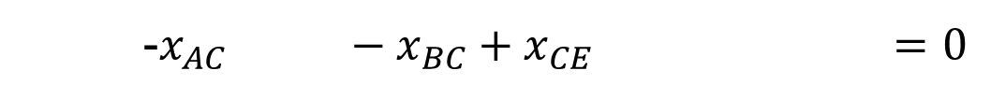
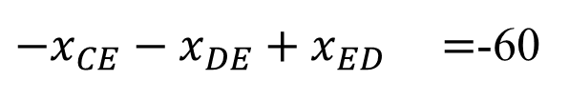
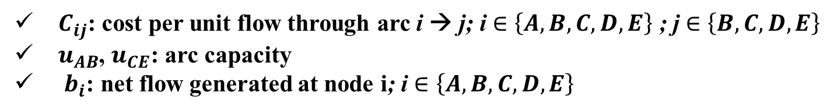
The objective function
Minimize The total shipping cost
$Z=2x_{AB}+4x_{AC}+9x_{AD}+3x_{BC}+x_{CE}+3x_{DE}$+2$x_{ED}$
Constraints
$$x_{AB}+x_{AC}+x_{AD} =50$$
-$x_{AB} +x_{BC} =40$
-$x_{AC} −x_{BC}+x_{CE} =0$
-$x_{AD} +x_{DE}−x_{ED} =$-30
${−x}_{CE}−x_{DE}+x_{ED} =$-60
Decision variables
$x_{ij}$: flow through arc i → j ; i $∈\left\{A,B, C,D,E\right\}$ ; j $∈\left\{B, C,D,E\right\}$
Parameters
$C_{ij}$: cost per unit flow through arc i → j; i $∈\left\{A,B, C,D,E\right\}$ ; j $∈\left\{B, C,D,E\right\}$
$u_{AB}$, $u_{CE}$: arc capacity
$b_{i}$: net flow generated at node i; i $∈\left\{A,B, C,D,E\right\}$

Slide 3
